Slide 1
Antenna Modeling
Is it worth it?
Brief demonstration of antenna modeling. When is modeling useful.
Bloomington Amateur Radio Association – March 12, 2024 7:00 pm
Roger Roth K0MPH

Slide 2
Roger K0MPH
Licensed at age 15 - Wanted to make my own radios
Went to engineering school to learn to make radios
Never made a radio
Homebrew station equipment and antennas
HF contester – especially CW
Model most of my homemade antennas
Live in a townhouse with HOA restrictions
Notes:
Mantra of the day “Radio here is homebrew” .... Made no radio in my career or hobby. Started a QRP rig but the receiver didn’t work due to insufficient PC board grounding.

Slide 3
What is antenna modeling?
Process to predict antenna performance without building a real antenna.
Based on the laws of physics modelled using mathematics.
Input- Antenna definition – wires/conductors, sources, loads, transmission lines, ground, etc
Output - Predict radiation pattern and load impedance (SWR) for one or more frequencies
Goal: What do you want the antenna to do? Does it work the way you want?
If not, make changes and try again (without building a real antenna)
Notes:
Input and output to model. Wire or tubing..... Sources: transmitter. Loads: inductors, capacitors, resistances. Goal:

Slide 4
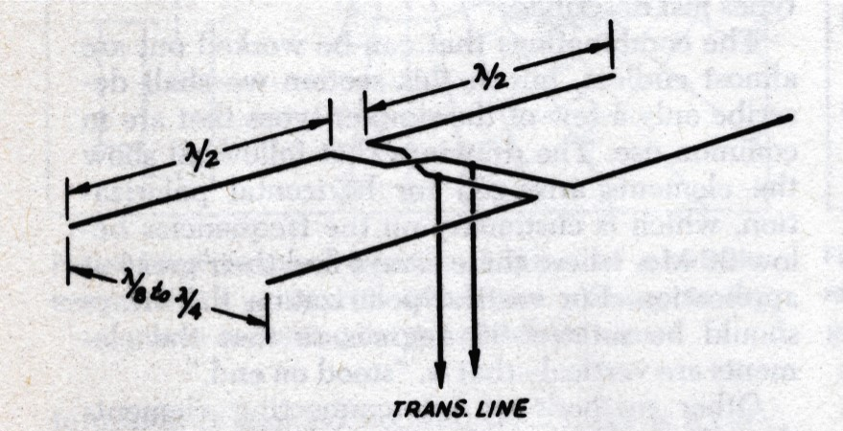
Mathematical modeling
Engineering school antenna class
Book “Antennas” by Jack Kraus W8JK
Wrote equations for modelled antenna
Trigonometry, calculus, and algebra to plot free space radiation patterns
Simple antennas
Tedious and error prone
Not easy to try variations.
Notes:
Ohio State University professor. W8JK antenna two spaced parallel full wave antennas feed out of out of phase wit one another - bidirectional. .... Manipulated equations to make a fee space radiation pattern.... Forgot how to do it long ago.

Slide 5
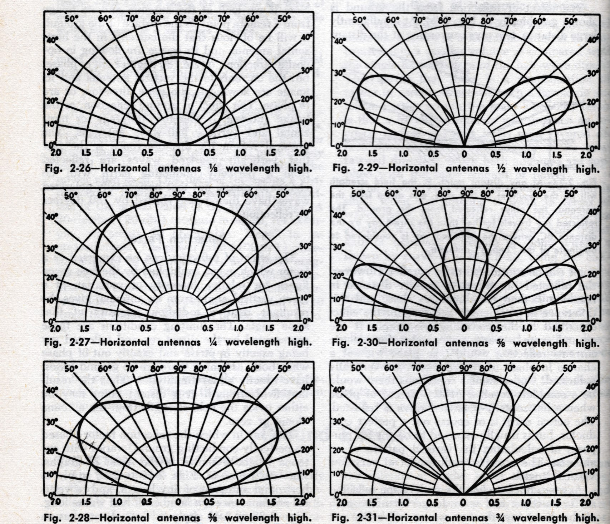
ARRL Antenna Book - 1970
Broadside to dipole
Different heights
Perfect ground
Mathematical model

Slide 6
Computer modeling
Computer simulation (approximation) of the mathematics
Flexible method of defining the modeled antenna
Including wire material, size, and insulation; ground condition; transformers, inductors, capacitors, transmission lines
Performance charts and plots (SWR, azimuth, elevation, 3D)
Easy to try many cases. What happens when:
  Frequency changed (SWR, gain, front to back ratio)
  Dimension changed (optimization and tolerance)
  Height above ground changed
  Design changed
Notes:
Works by calculating breaking up the wires into segments, calculating the currents in the segments, summing the radiation from each segment at some faraway place in all directions. ... How sensitive is performance to frequency, dimension or load changes?

Slide 7
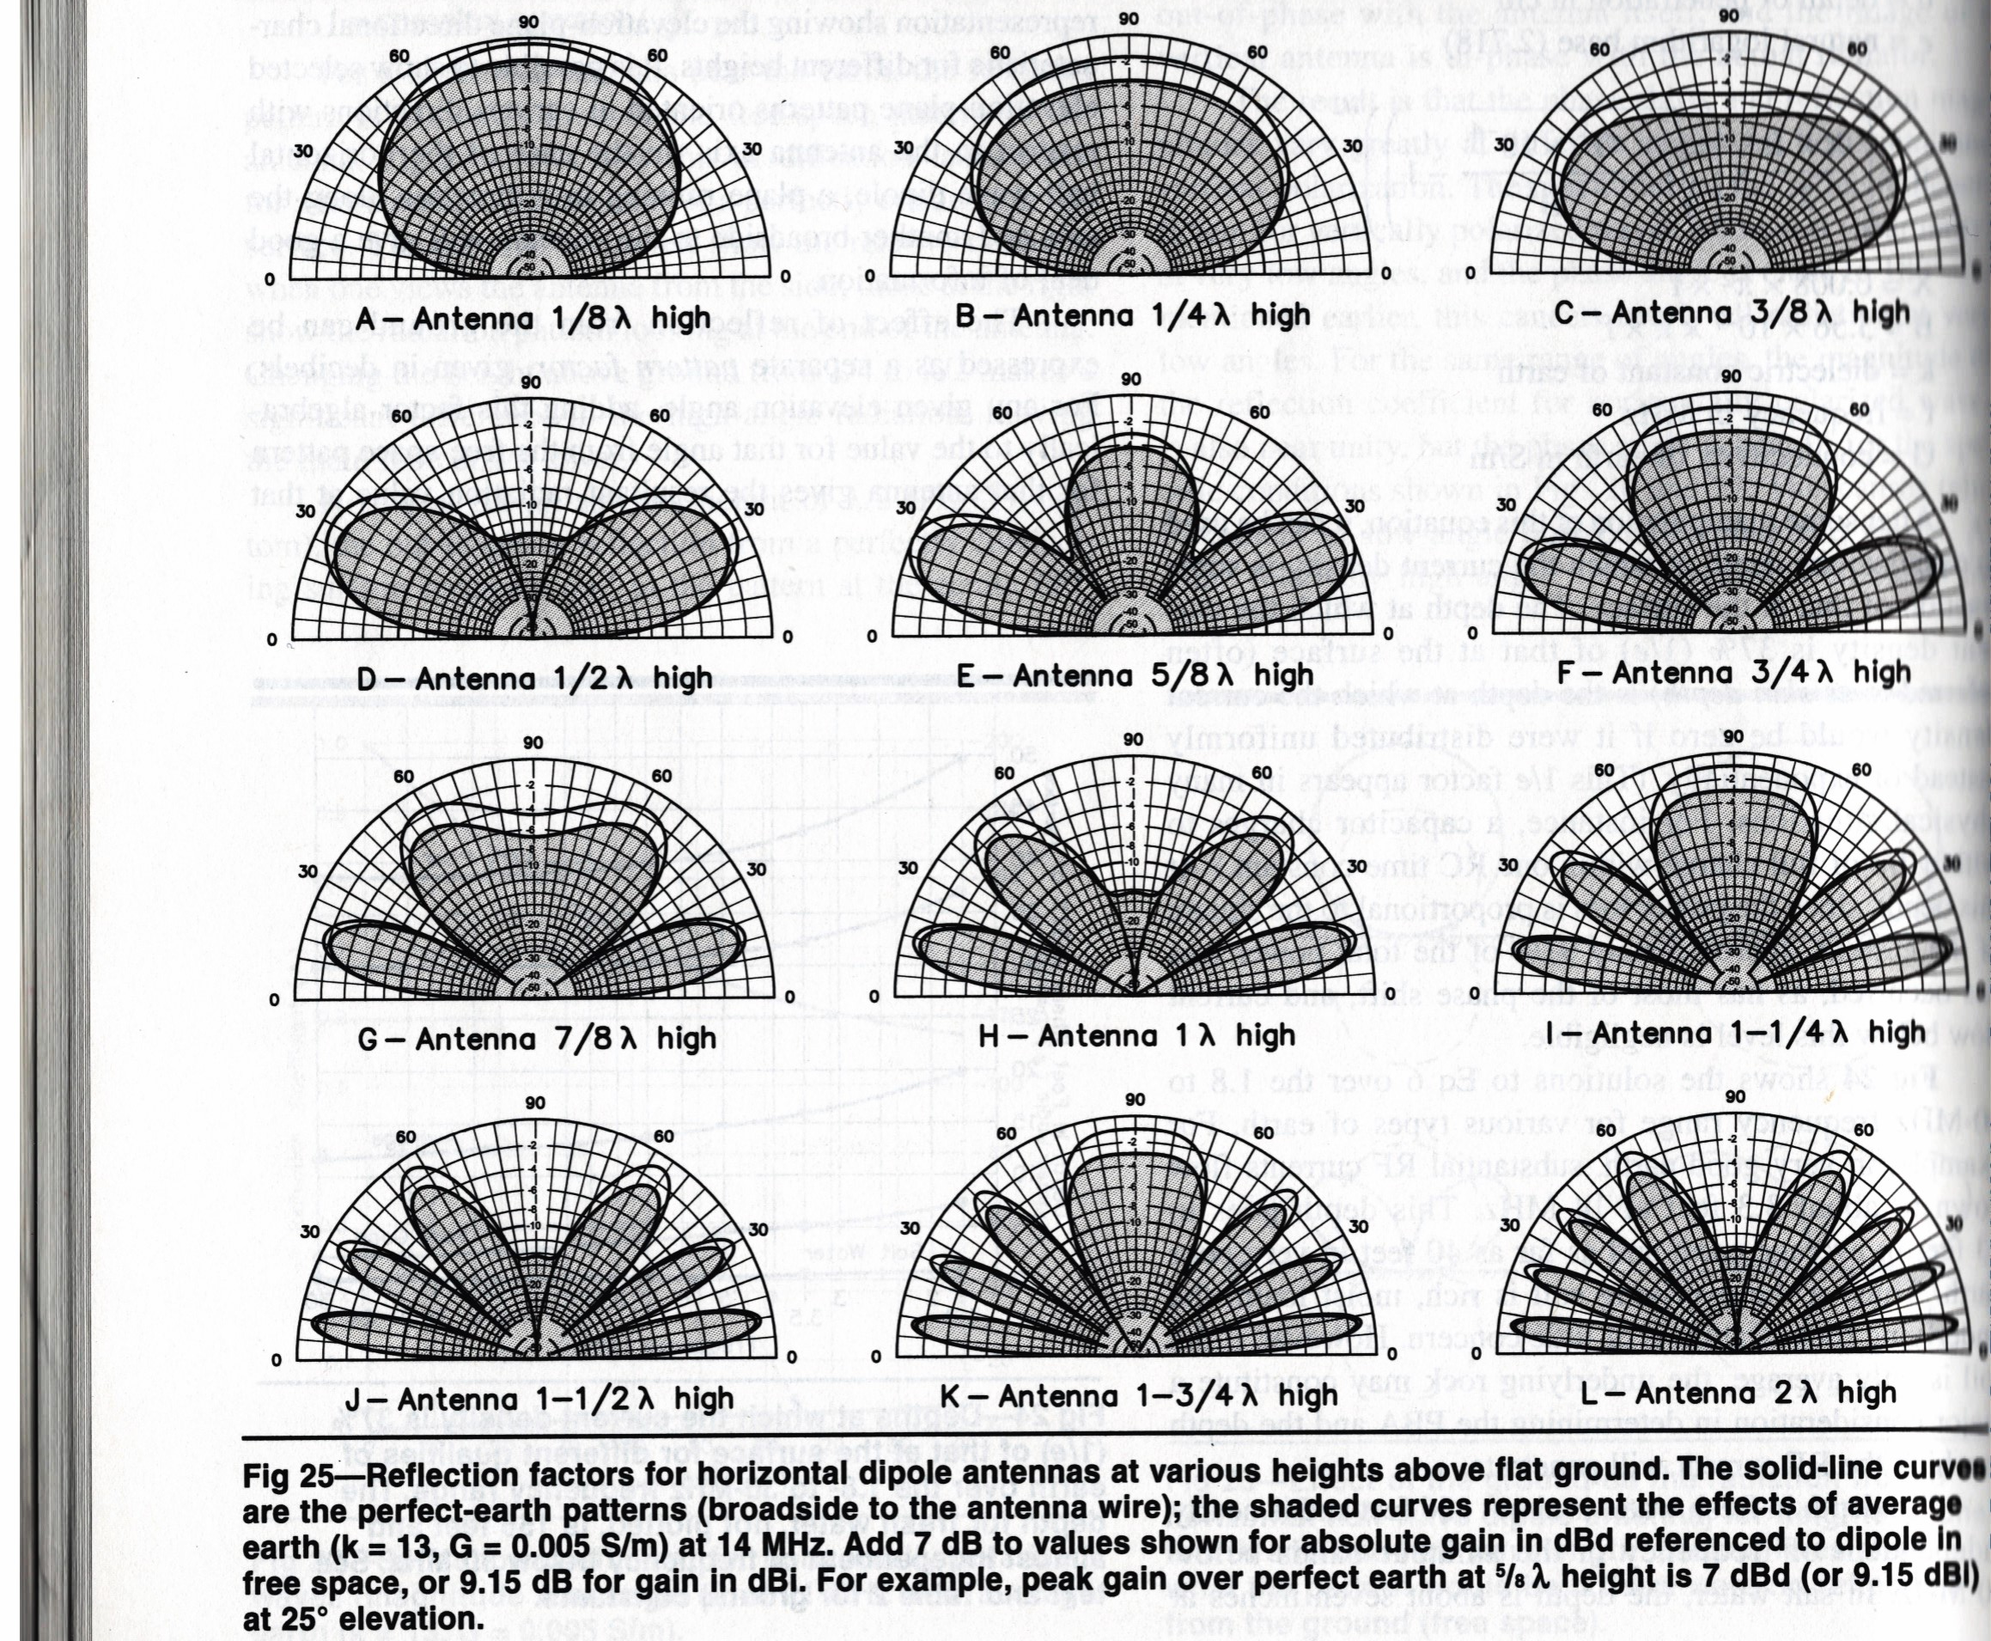
ARRL Antenna Book – 20th Edition - 2003
Broadside to dipole
Different heights
Perfect and average ground
Computer model

Slide 8
Modeling not perfect
Computer simulation makes approximations
  Limited precision calculations
  Limited number of segments
  Limits (wires can not be buried in the ground)
Antenna cannot be built exactly the same as the model
  Measurement tolerance, inductance/capacitance
  Sagging wires
Model doesn’t include everything near the antenna
  House wiring not included
  Boat trailer parked in you back yard
Notes:
Model near buildings not likely to be accurate.... Better to be in an open field.

Slide 9
Typical Computer Modeling Program
EZNEC – by W7EL Roy Lewallen
  Complete modeling program
  Roy is retired – Free with no Support – https://eznec.com/
AutoEZ – by AC6LA Dan Maguire
  Excel spreadsheet companion to EZNEC
  Makes EZNEC easier to use
  Uses variables to control the model – automatic scaling
  Automatically make changes to the model for multiple test cases
  $79 - https://www.ac6la.com/autoez.html

Slide 10
Typical Computer Modeling Program
NEC2GO
  Complete modeling program
  Uses of variables to control the model for multiple test cases
  $39.95 - https://nec2go.com/
Notes:
Not as handy as AutoEZ.. Hasn’t been updated recently.

Slide 11
What is dbi (isotropic)?
  Isotropic radiator is a theoretical antenna in free space that radiates equally well in all directions.
  Point source. Infinitely small. Completely removed from everything else (free space).
  Radiates equally well in all directions (no directivity).
  By definition an isotropic radiator has a gain of 0 dbi.
  Used as a measuring stick for comparison with an actual antenna system.
  Used to compare antennas.
Notes:
Reminder of basics... Not real but still useful as a reference. .... Dbd – uses a standard dipole in free space as a reference. Dipole has directivity. Seems confusing to me.

Slide 12
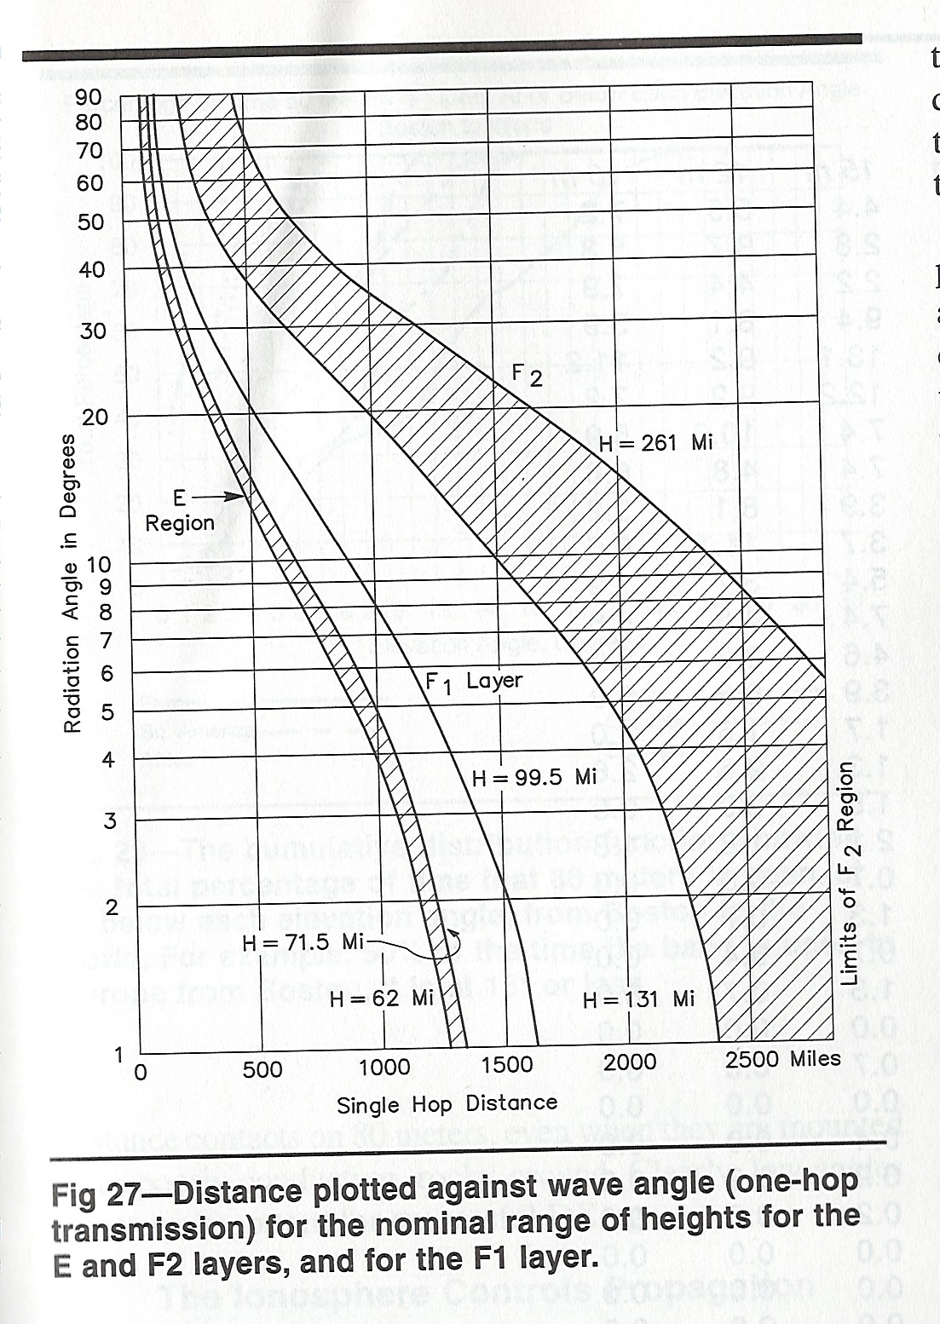
What wave angle is useful ?
Varies with height of F1 and F2 ionosphere layer
MN to | Miles | Wave angle deg
IL | 350 | 20 - 80
OH | 700 | 10 – 40
NYC/TX | 1100 | 7 – 30
WA/AZ | 1200 | 7 – 30
FL | 1400 | 5 – 25
CA/BC | 1600 | 3 – 20
DX |  | 1 – 10
Notes:
Radio signals reflects from the ionosphere. What angle supports radio propagation. Depends on time of day, frequency, season, space weather.... Important because we need to look at elevation plots to determine if the antenna meets our goals.

Slide 13
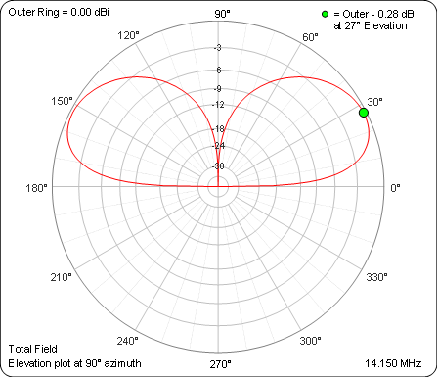
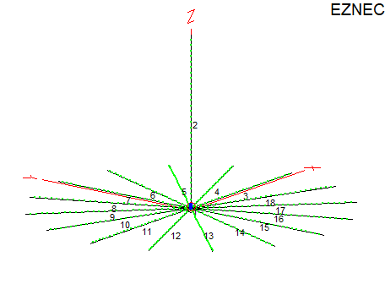
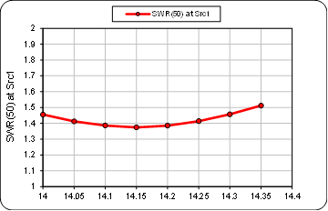
20 Meter Vertical Model
17.3 ft tall telescoping, sixteen - 16 ft radials
At 14.150 Mhz - SWR 1.4
  Maximum signal: -0.28 dbi at 27 deg elevation
Notes:
Telescoping antenna

Slide 14
Modeling example - POTA Antenna
What would be the best POTA antenna?
  Inexpensive
  Easy/quick to deploy, park friendly, doesn’t require stakes in the ground
  Works well on 20,17,15,12,10 – bonus 40
  Reaches both coasts and the Midwest.
  Is it directional? Preferred deployment orientation.
Which is best?
  Vertical
  20-meter sloper
  CHA LEFS 8010 (Light weight end fed sloper)
Notes:
Parks on the air is popular. What does it take to get on POTA.... Already have to invest in a battery and maybe second radio... Safe – no wires to trip over.... Population areas in North America.

Slide 15
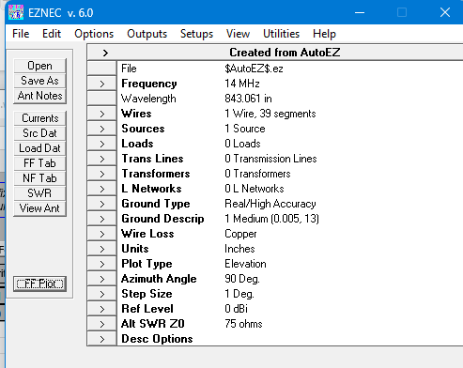
Sloper Model - EZNEC

Slide 16
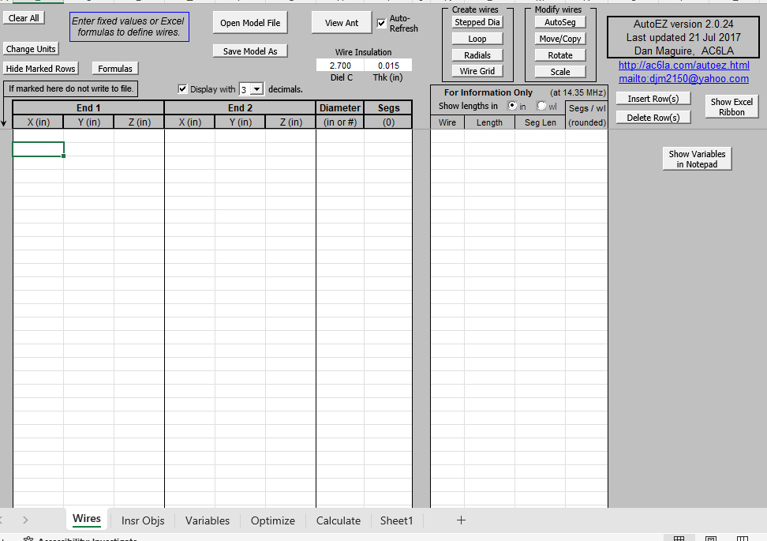
Sloper Model - AutoEz

Slide 17
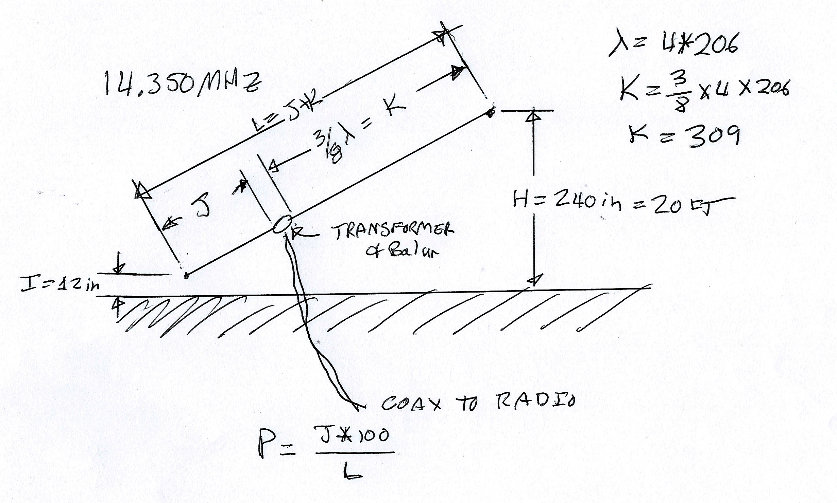
Sloper Model

Slide 18
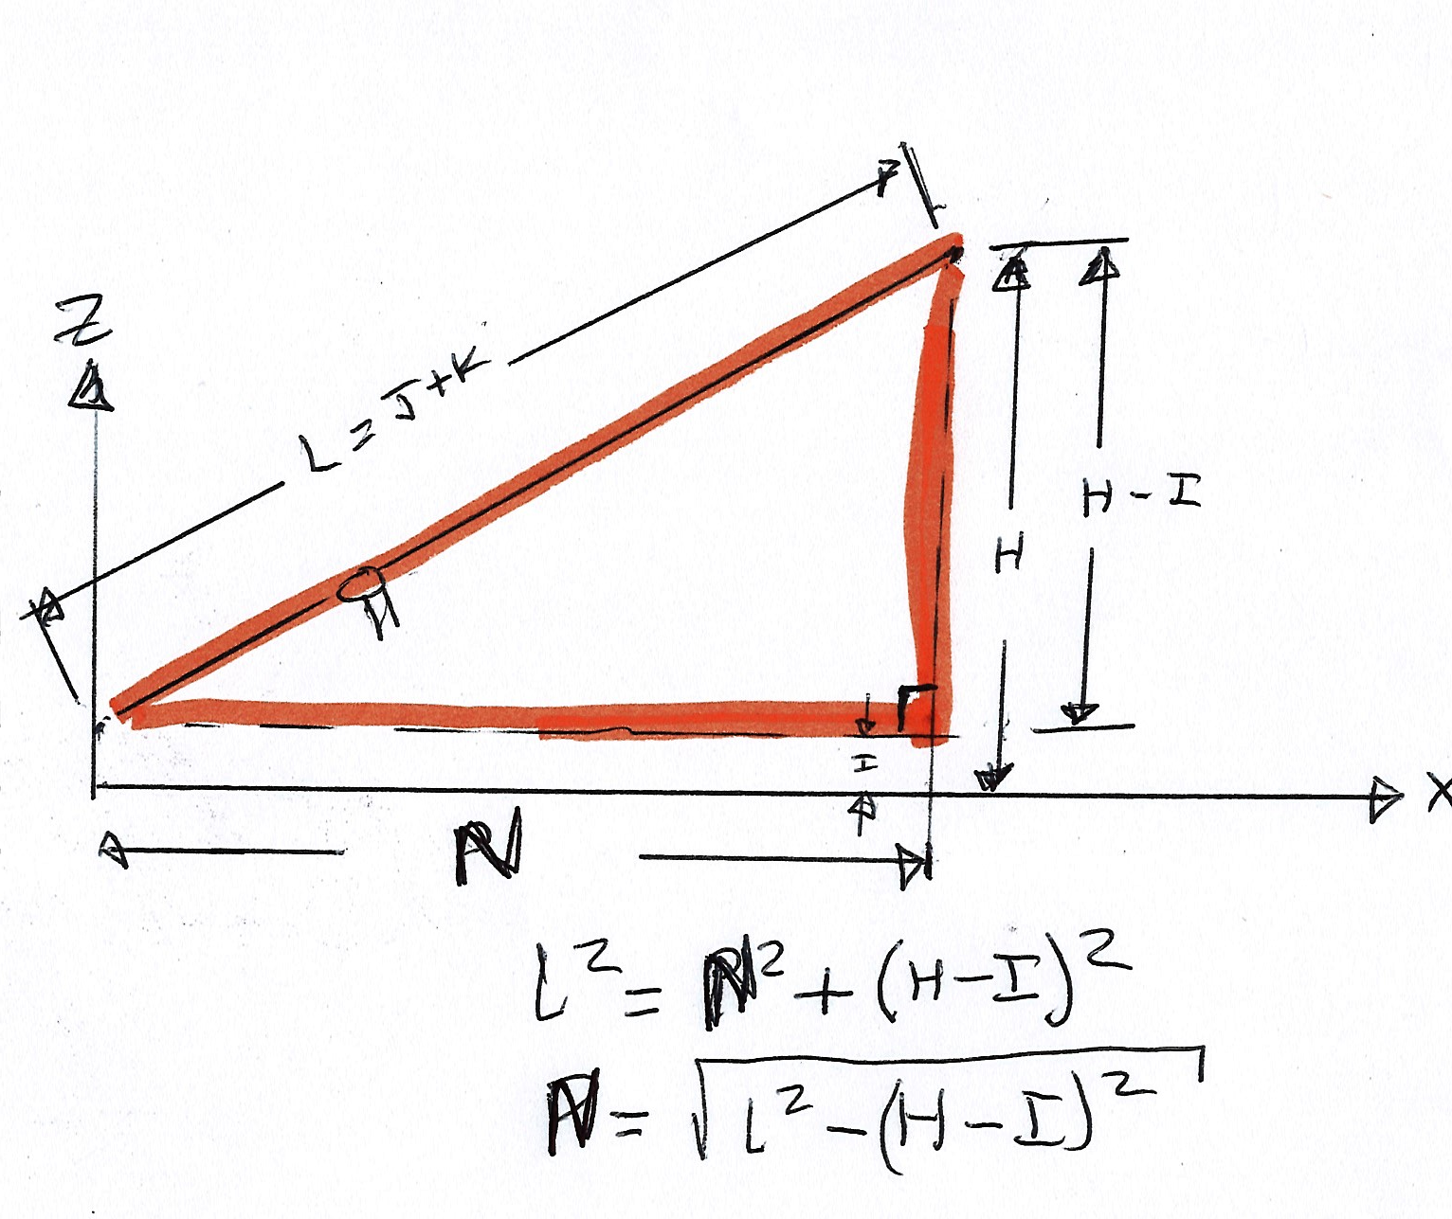
Sloper Model

Slide 19
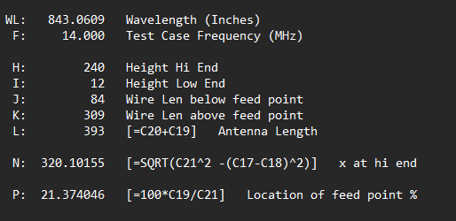
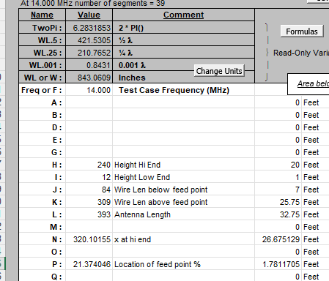
Sloper Model - Variables

Slide 20
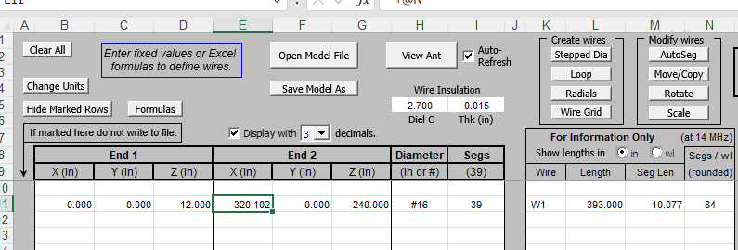
Sloper Model - Wires

Slide 21
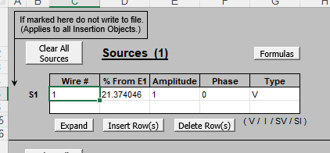
Sloper Model - Sources

Slide 22
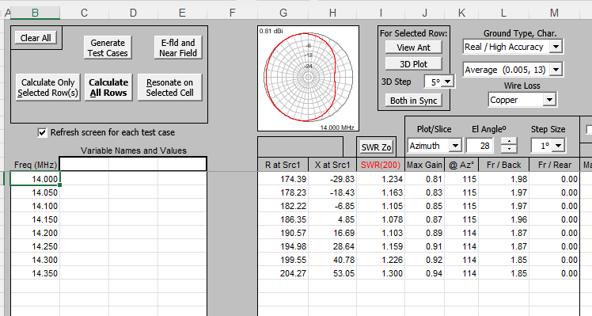
Sloper Model - Calculate

Slide 23
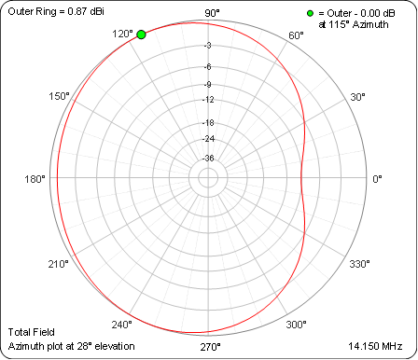
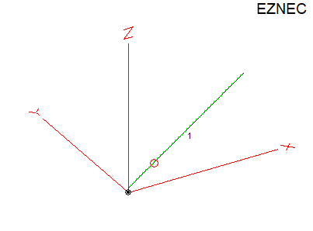
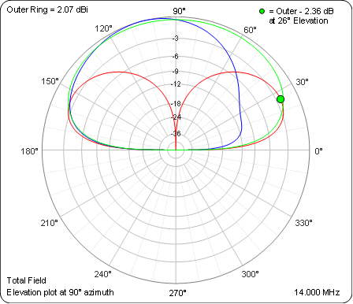
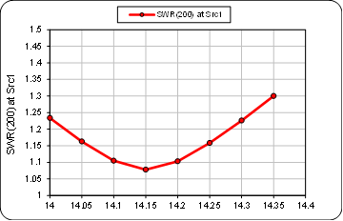
Sloper Model
Sloping 32.75 ft wire from 1 to 20 feet high
  4:1 transformer 7 feet from the bottom
At 14.15 Mhz – SWR 1.1
  Max signal: 2.3 dbi at 104 deg (directional)
  Vertical: Red End Fed: Blue and Green

Slide 24
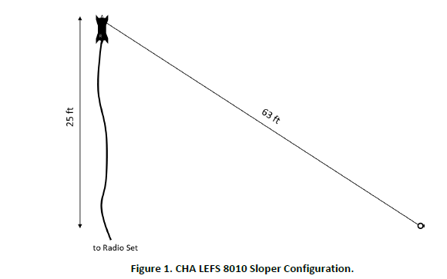
CHA LEFS 8010 (Light weight end fed sloper)
$225 - Designed for backpacker?? (1.5 lb) – use for POTA or FD
63 or 130ft sloper/flat top, 25 ft feed line/counterpose
49 to 1 transformer. 40,20,17,15,10 - 80,30 with extension

Slide 25
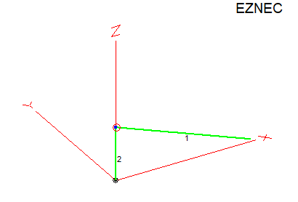
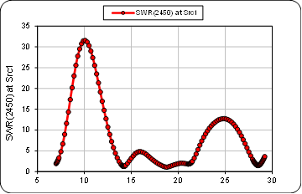
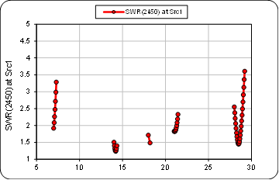
CHA LEFS 8010 (Light weight end fed sloper)
Model does not include in-line coil. Sloper longer instead, 68.3 ft
49:1 transformer, counterpose 24 ft
SWR reasonable 40,20,17,15,10 – affected by counterpose length

Slide 26
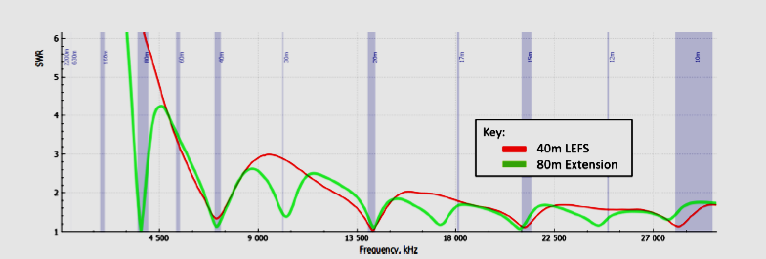
CHA LEFS 8010 (Light weight end fed sloper)
Model SWR compared to manufacturers curves
Maybe model does not represent actual antenna
Not accounting for loss in transformer or coil??

Slide 27
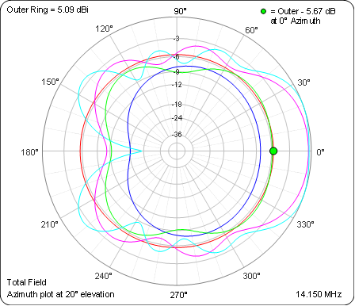
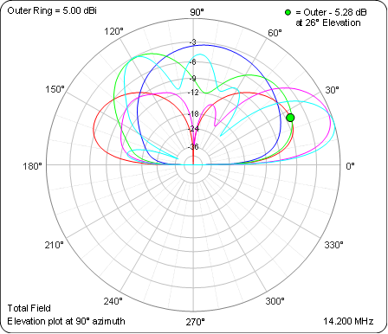
CHA LEFS 8010 (light weight end fed sloper)
Directional toward low end of slope. Manufacturer claims dipole pattern on 40 meters.
Compared with vertical - Red
  Blue – 40
  Green – 20
  Violet – 15
  Lt Blue – 10

Slide 28
Which antenna would be better for POTA?
Slopers:
  Requires matching transformer and balun
  Requiring hanging in a tree or heavy pole
  Directional
  Some bands have directional gain
  CHA LEFS 8010 Covers 40 meters
  CHA LEFS 8010 doesn’t require retuning when changing band

Slide 29
Which antenna would be better for POTA?
My choice is the vertical because:
  Can be easy to deploy
  Does not depend on trees or poles
  Omni-directional
  Easy to retune to other bands
  No matching transformer required. Still requires a balun
Downside:
  Requires retuning to change band.
  No gain
  40 meter performance not good in reasonable size

Slide 30
Vertical is my POTA antenna of choice
How many radials are really needed?
Number of Radials | Max Signal (dbi) | SWR 14.0 Mhz | SWR 14.15 Mhz | SWR 14.35 Mhz
16 | - 0.28 | 1.45 | 1.37 | 1.51
8 | -0.31 | 1.44 | 1.36 | 1.50
6 | -0.35 | 1.41 | 1.34 | 1.52
4 | -0.52 | 1.34 | 1.32 | 1.60
2 | -1.55 | 1.22 | 1.53 | 2.04

Slide 31
When is modeling useful?
Compare different antennas before buying or building
Increase knowledge of antennas
Select or design an antenna to meet a goal
  Test a design before building
  Initial dimensions and parameters before building
  Test sensitivity to dimension variation
  Expect to adjust or tune the antenna after it is built

Slide 32
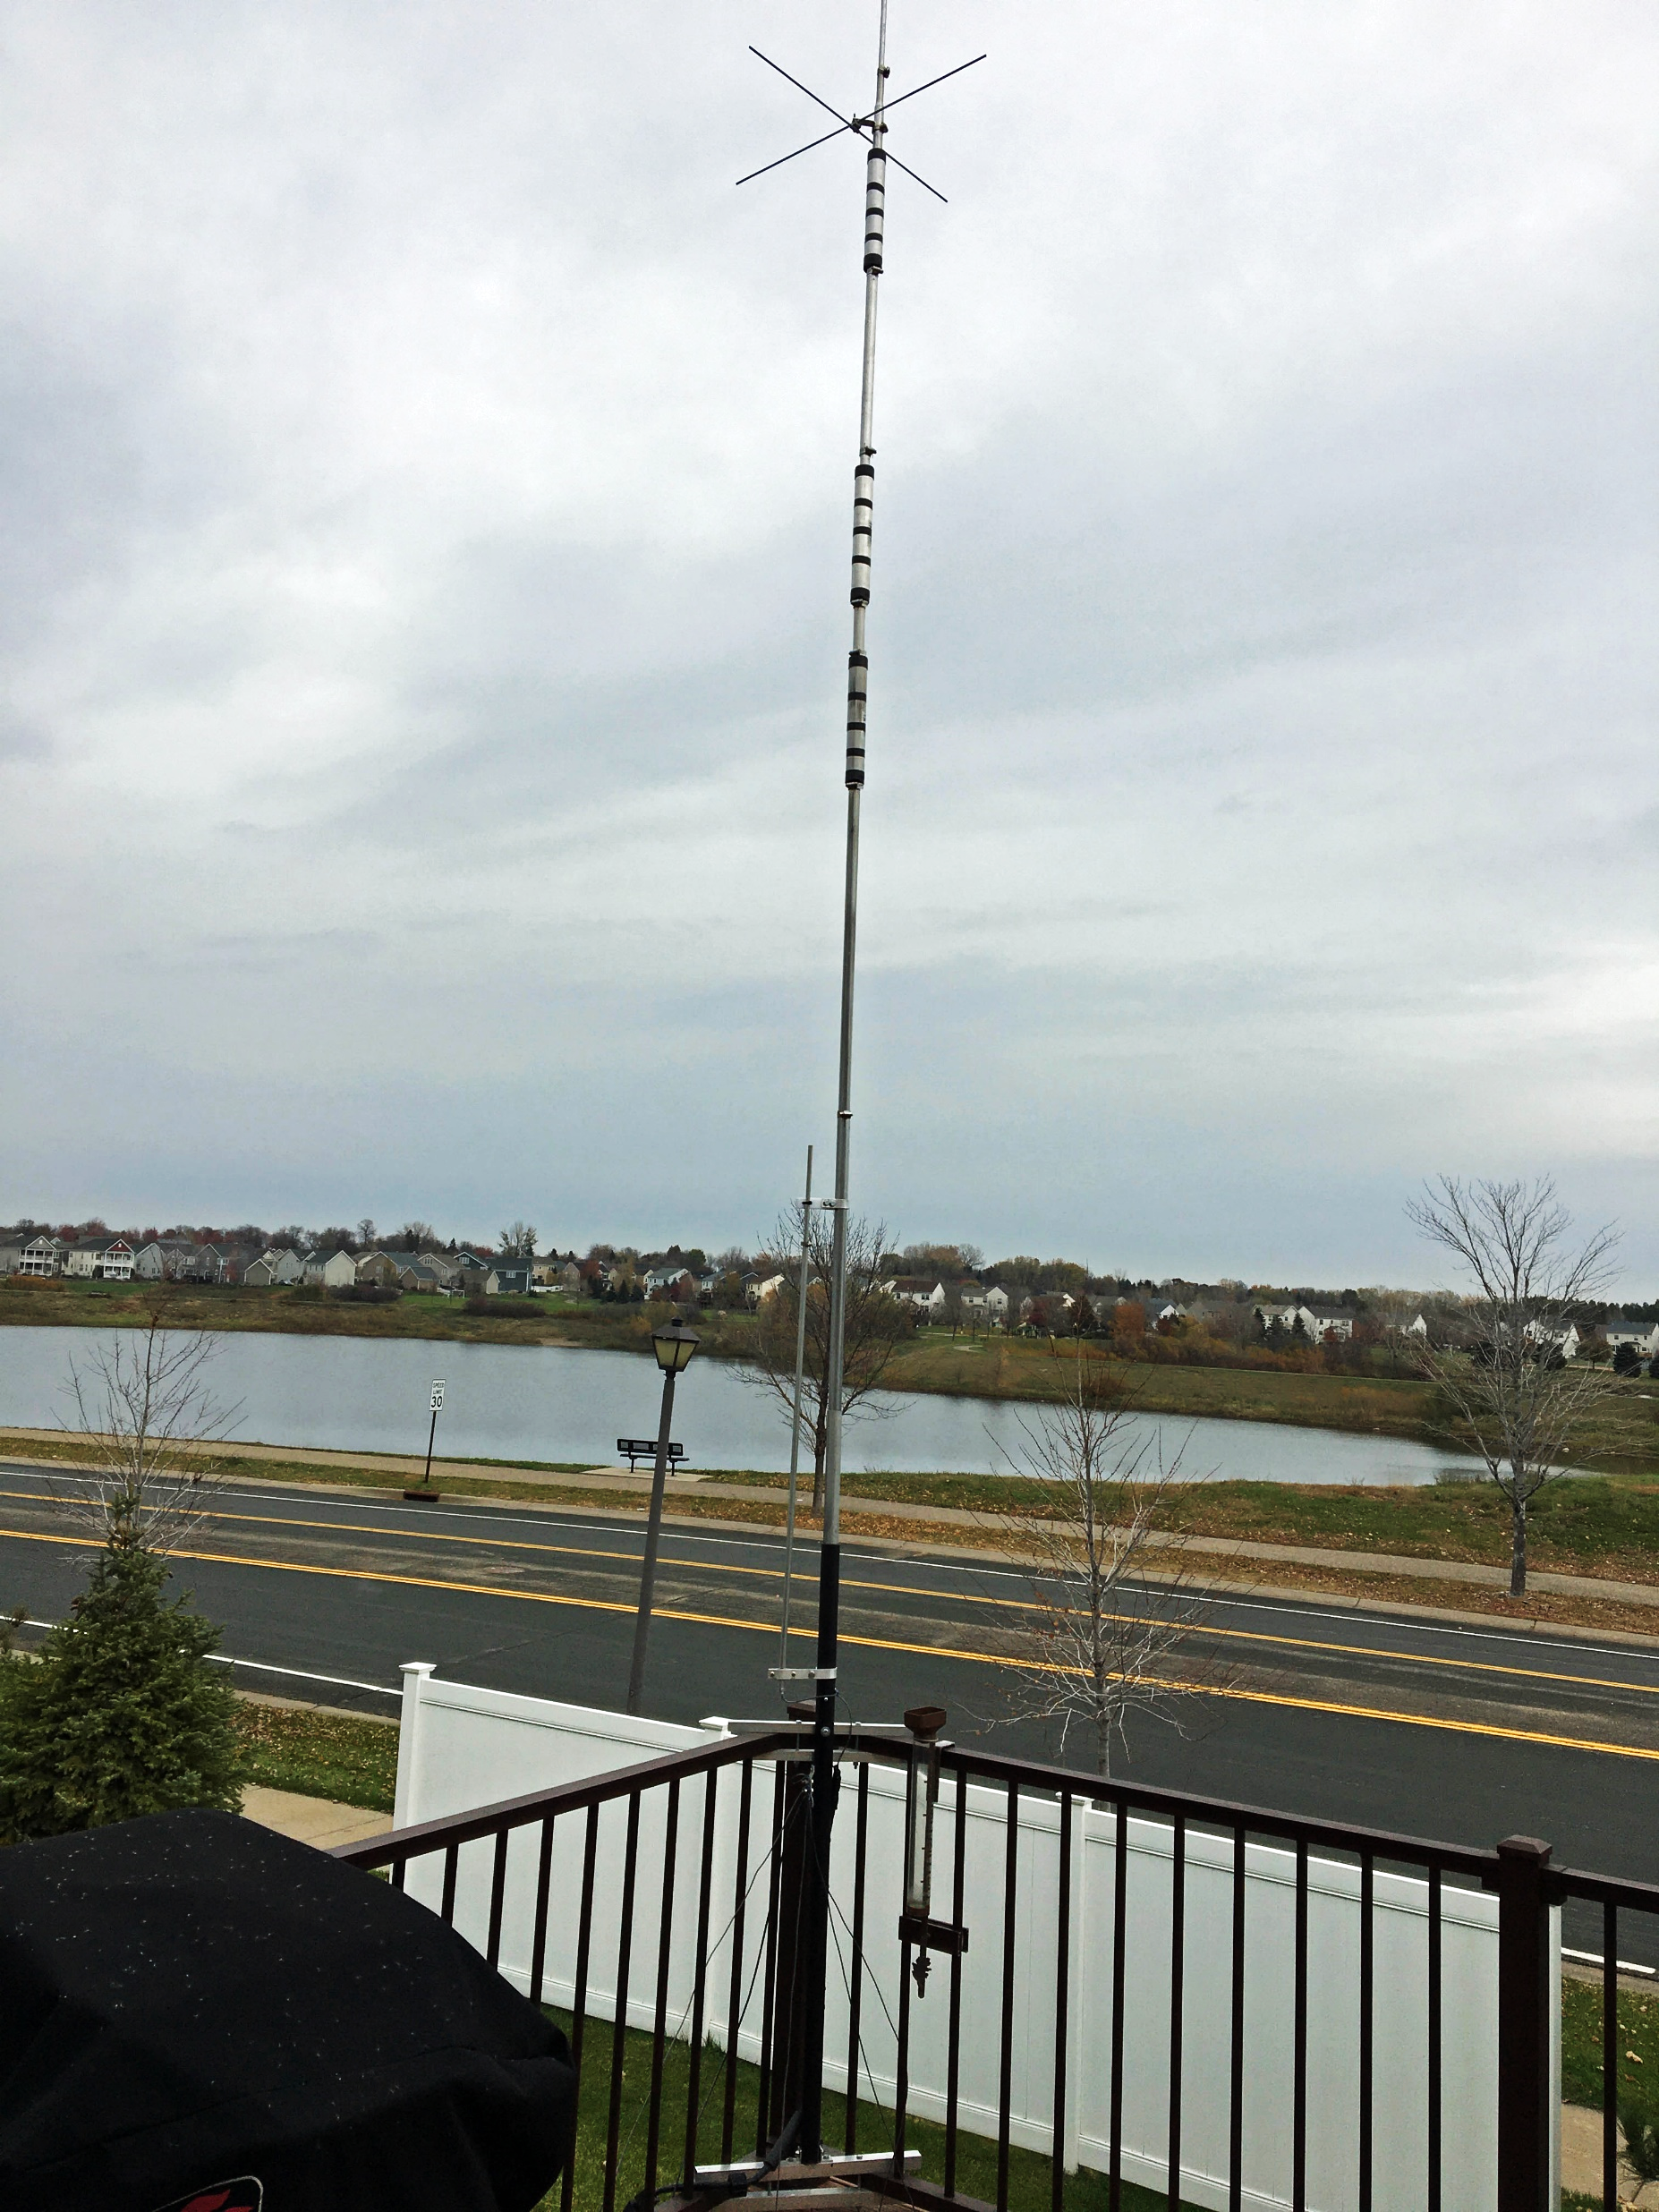
When modeling not useful
Commercial antenna when some
  dimensions or parameters are not known
Antenna located in cluttered location
The antenna is something well
  documented

